Slide 1
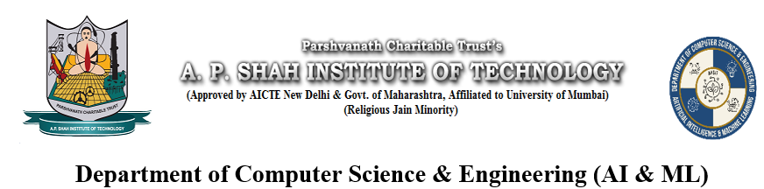
RO Service Management System
Theme-SDGGoals16 Peace,Justice and Strong Institutions
Category- Software
Group No -8
Group Members- Susheel Yadav, Kuwar Singh, Aditya Sambare, Ayush Singh
Guide- Prof. Priyanka Patil

Slide 2
Outline
Introduction
Literature Survey
Limitations of existing systems
Problem statement and Objectives
Proposed Methodology
Experimental Setup
Implementation
Results & Analysis
Conclusion and Future work
References

Slide 3
Introduction
Background & Importance
RO / water purifiers are widely used for safe drinking water.
Many small RO providers manage sales and service manually (phone, registers).
This causes delays, missing records and confusion between customer, staff and technician.
No clear proof of who handled which request and when → weak accountability.
Need a simple web‑based system for organized and reliable service.
Linked to SDG 16 – Strong Institutions (better processes and records).

Slide 4
Introduction (Current Challenges & Motivation)
Service process is fragmented: phone calls, notebooks, WhatsApp messages.
Hard to track service status, technician work and service history.
Difficult to resolve disputes because there is no proper record.
We observed these issues in real RO service and mini‑project examples.
Motivation: build a transparent, trackable RO service system for fairness.
Hence selected RO Service Management System mapped to SDG 16.

Slide 5
Introduction (Proposed Solution & Expected Impact)
Develop a simple web‑based RO Service Management System for all users.
All users register and login with a role (Customer / Staff / Technician / Admin).
Customer: can view products, raise service/repair requests and track status.
Staff: manages customer details, sales records and assigns requests to technicians.
Technician: sees assigned jobs and updates service status after work.
Admin: monitors all customers, staff, technicians and service status in one place.

Slide 6
Literature Survey
Sr. No. | Year | Title | Research
1 | 2025 | Smart IoT-Based RO Monitoring System | This research focuses on using IoT sensors to monitor water quality in real-time and send alerts for maintenance, improving efficiency of RO systems.
2 | 2023 | IoT-Based Predictive Maintenance for Water Purifiers | This study uses AI and IoT to predict faults in RO systems and notify users before failure, reducing downtime and maintenance cost.
3 | 2020 | Design and Development of Water Management System | This paper presents a system for monitoring and managing water systems using basic software and hardware integration.
4 | 2018 | RO Plant Status Monitoring System | This research focuses on automation and fault detection in RO plants to improve system reliability and performance.

Slide 7
Limitations of existing Systems
Sales, customer data and service requests are not in one integrated system.
No real‑time status tracking for customers, staff or technicians.
Service history and technician actions are not recorded clearly.
Heavy manual work → data loss, errors and difficulty in resolving disputes.
Small RO businesses cannot adopt large enterprise CRM tools.

Slide 8
Problem statement and Objectives
Problem: RO providers use fragmented, manual methods (calls, paper, Excel) for sales and service.
This leads to slow response, missing records and low transparency.
Need a simple web system that tracks all users (customer/staff/technician/admin) and all actions.
Objective 1: Digitalize RO sales, customer details and service/repair requests.
Objective 2: Provide role‑based access with full history of assignments and status changes.

Slide 9
Proposed Methodology
Architecture: 3‑tier web app → UI (browser) → Flask app → Relational DB.
User registration with role selection (customer / staff / technician / admin).
User login → system opens role‑specific web page based on role and ID/password.
Database tables: users (with role), customer details, staff/technician details, products, service requests, service history.
Main flow:
Customer raises request → Staff assigns technician → Technician updates status → Admin monitors all.

Slide 10
Experimental Setup
Input data: sample customers, staff, technicians, RO products and service requests.
Each request stores: customer, product, assigned technician, dates and current status.
Evaluated: workflow correctness, time to log / assign / close requests, and data consistency.
Hardware: normal laptop/PC (≥ 4 GB RAM) with internet / LAN.
Software: HTML, CSS, JavaScript (frontend); Python Flask (backend); SQLite / MySQL DB; VS Code; web browser.

Slide 11
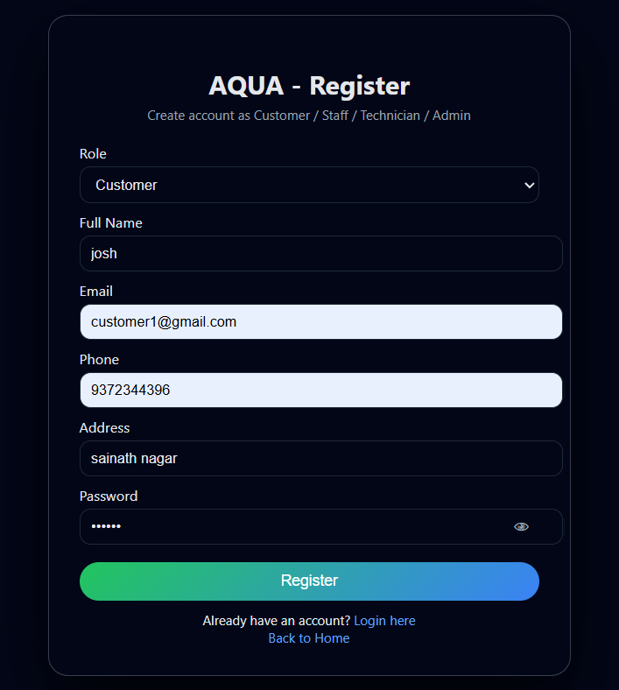
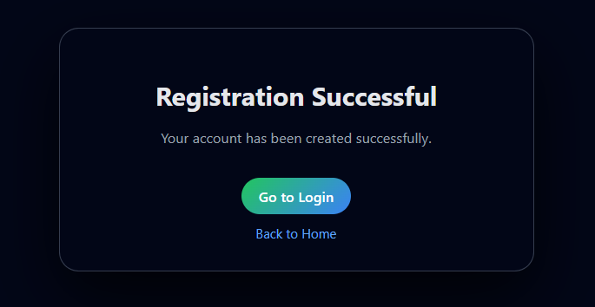
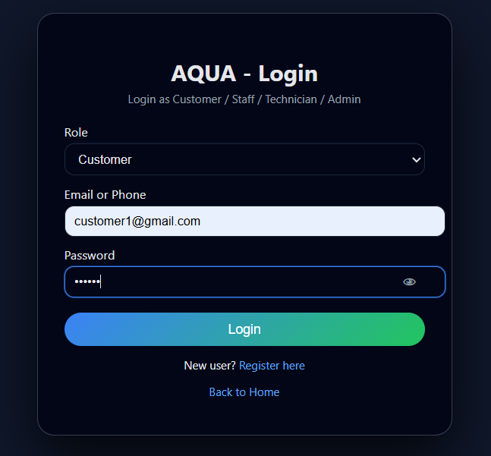
Implementation
New users register with basic details and role selection.
On login, system checks ID, password and role.
Successful login → redirects to role‑specific web page.

Slide 12
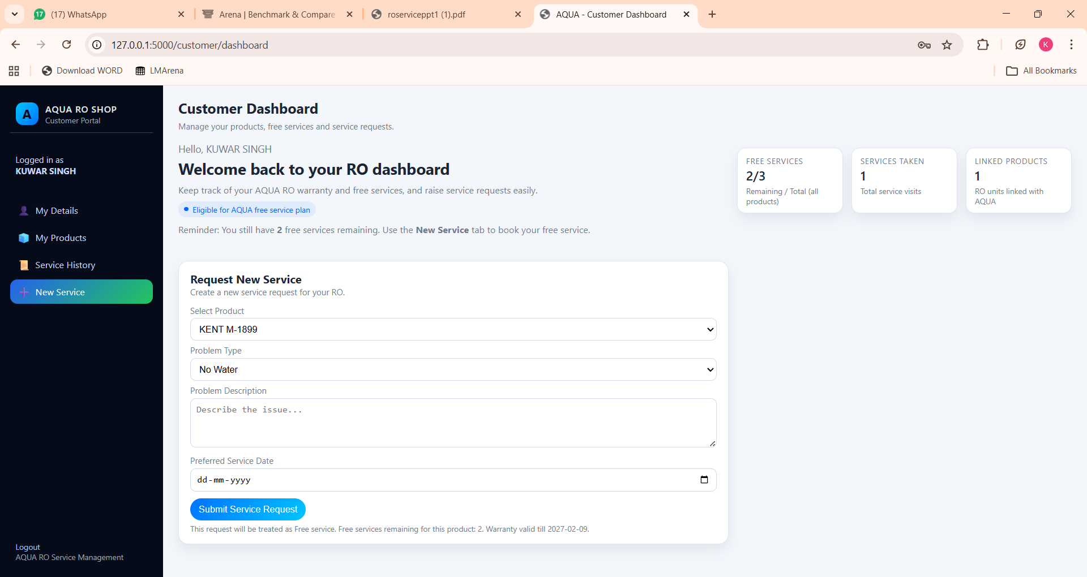
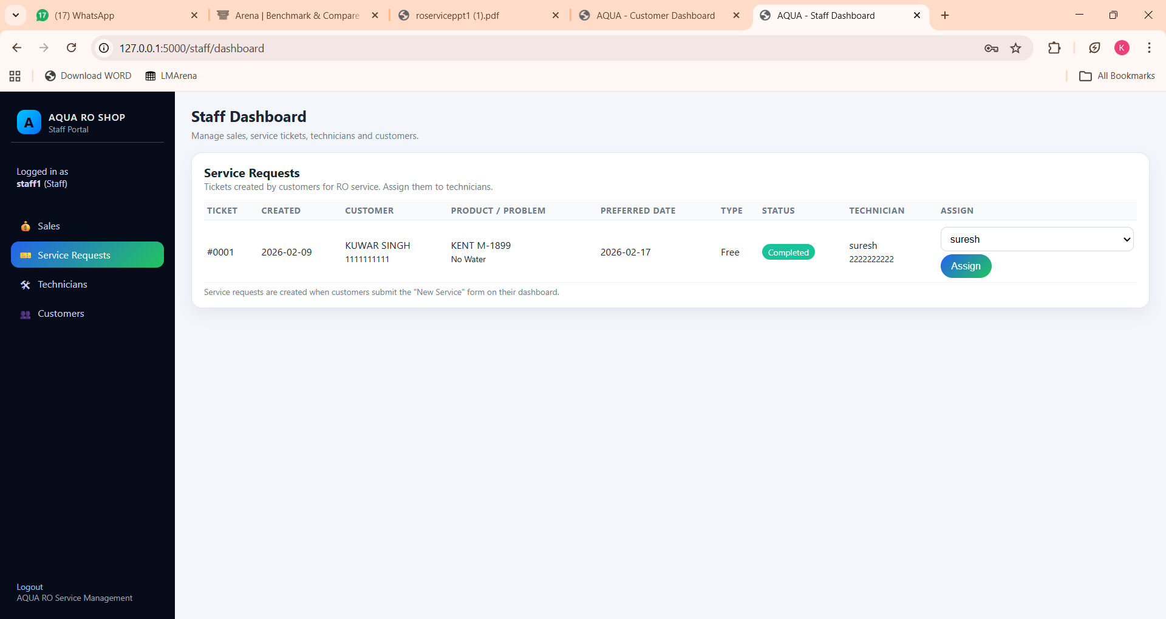
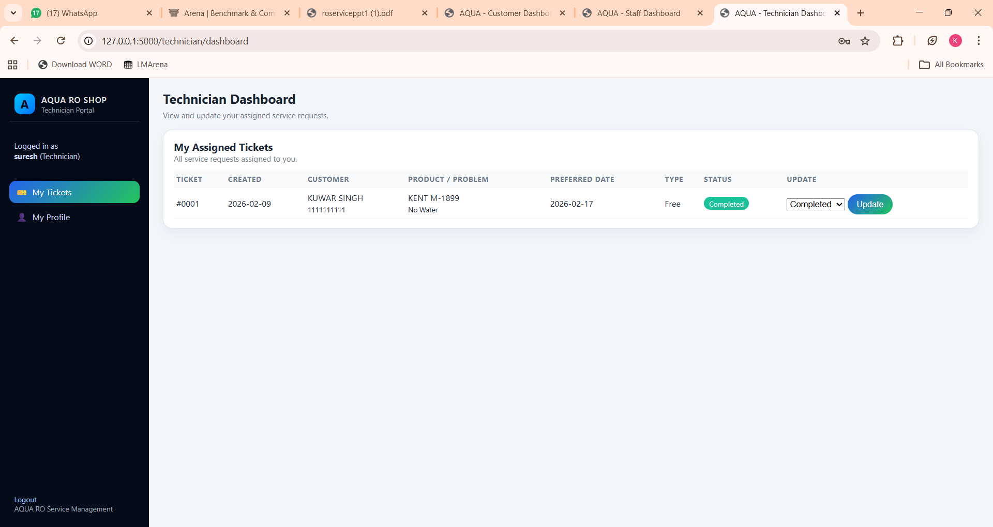
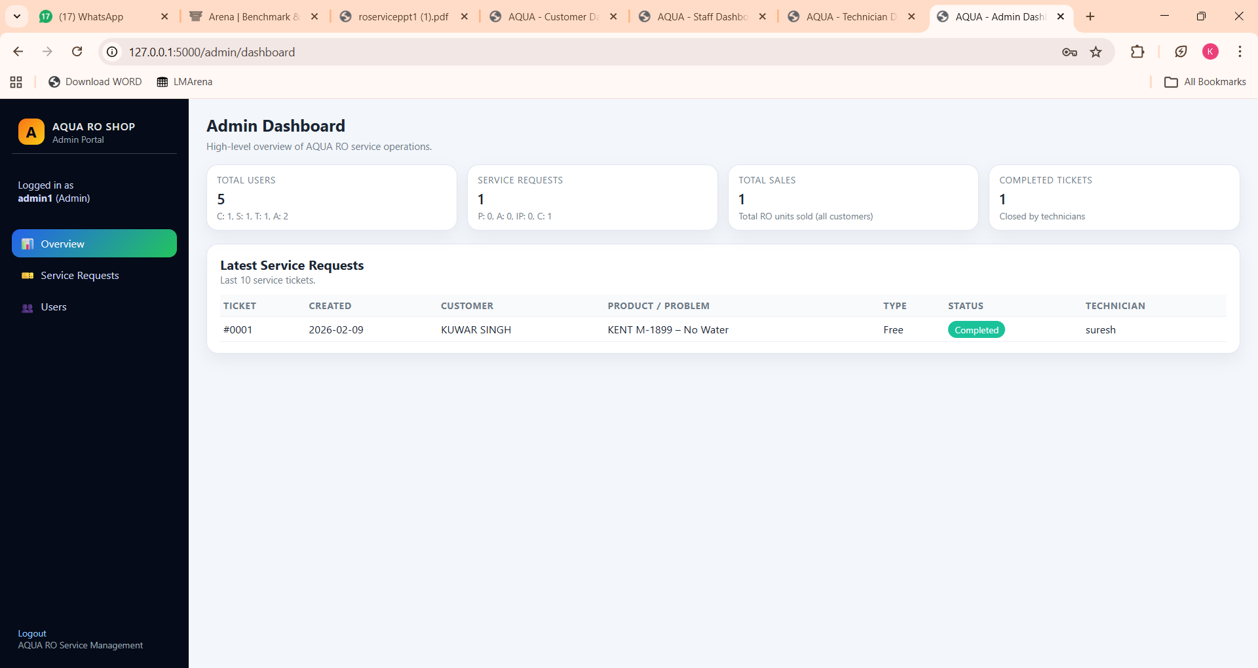

Slide 13
Results & Analysis
Traditional ML metrics (Accuracy, Precision, Recall, RMSE, Confusion Matrix) are not applicable here.
Comparison done between manual process and proposed system on sample requests.
Observations:
Fewer manual steps to register and assign a service request.
No loss of data; service history and technician actions remain stored in DB.
Service process becomes faster, more organized and more transparent.
Helps build a strong, accountable service institution, aligned with SDG 16.

Slide 14
Conclusion and Future work
Developed a web‑based RO Service Management System with role‑based login (Customer / Staff / Technician / Admin).
Centralized customers, products, staff, technicians and service requests in one database and enabled online booking + status tracking.
Reduced manual work, errors and confusion, making the service process more transparent and accountable (linked to SDG 16).
Successfully deployed on PythonAnywhere and made it live online.

Slide 15
References
[1] United Nations, Transforming our world: the 2030 Agenda for Sustainable Development, A/RES/70/1, 2015. [Online]. Available: https://sdgs.un.org/2030agenda
[2] R. T. Rust and P. C. Verhoef, “Optimizing the marketing interventions mix in intermediate-term CRM,” Marketing Science, vol. 24, no. 3, pp. 477–489, 2005. doi: 10.1287/mksc.1050.0118
[3] A. K. Tripathy and D. P. Mishra, “Design and implementation of an online complaint management system,” in Proceedings of the International Conference on Computational Intelligence and Communication Networks (CICN), 2016, pp. 560–564. doi: 10.1109/CICN.2016.119
[4] S. Niranjan, R. S. Reddy, and K. R. Prasad, “SMS-based automated notification system for service delivery,” in Proceedings of the International Conference on Communication and Signal Processing (ICCSP), 2017, pp. 1700–1704. doi: 10.1109/ICCSP.2017.8286640
[5] Pallets Projects, “Flask Documentation,” 2024. [Online]. Available: https://flask.palletsprojects.com/

Slide 16
Thank You...!!

